Slide 1
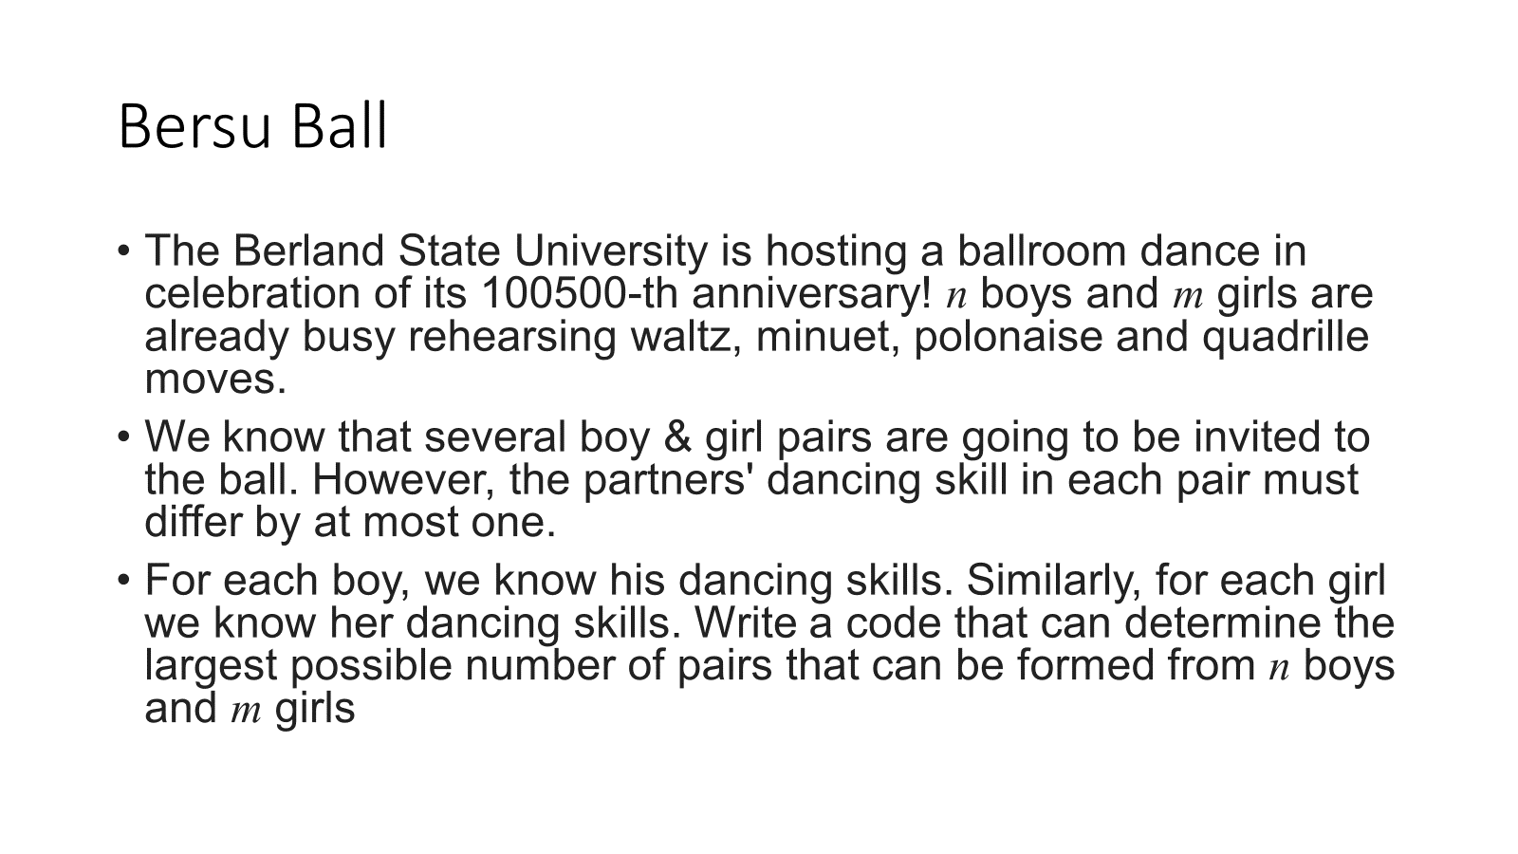

Slide 2
Bersu Ball - Examples
Let the skills of the boy be: {1,4,6,2}
And
the skills of the girls be: {5,1,5,7,9}
Ans 3
Pairs being: (1,1), (4,5), (6,5)

Slide 3
Bersu Ball - Input and Output
Input file consists of 4 lines
4 #number of skills of boys
1 4 6 2 #skills of boys
5 #number of skills of girls
5 1 5 7 9 #skills of girls
Single line output
3 #number of pairs modulo 10**9+7

